Slide 1

WeChat
Rachel Guo

Slide 2

What is it?
Multi- purpose messaging, social media and mobile payment app
Developed by Tencent
IOS, macOS, Androids, Windows
Released in 2011
Became one of the world’s largest standalone mobile apps in 2018
Over 1 billion monthly active users

Slide 3

Tencent
Products include search engine, social networking, instant messaging, mass media, web portals, e- commerce, web browser, antivirus software, artificial intelligence, music, payment system, film production, video games, online services.

Slide 4

Features
Messaging
Official Accounts
Moments
WeChat Pay (digital payment services)
Enterprise WeChat
Mini Program

Slide 5


Slide 6

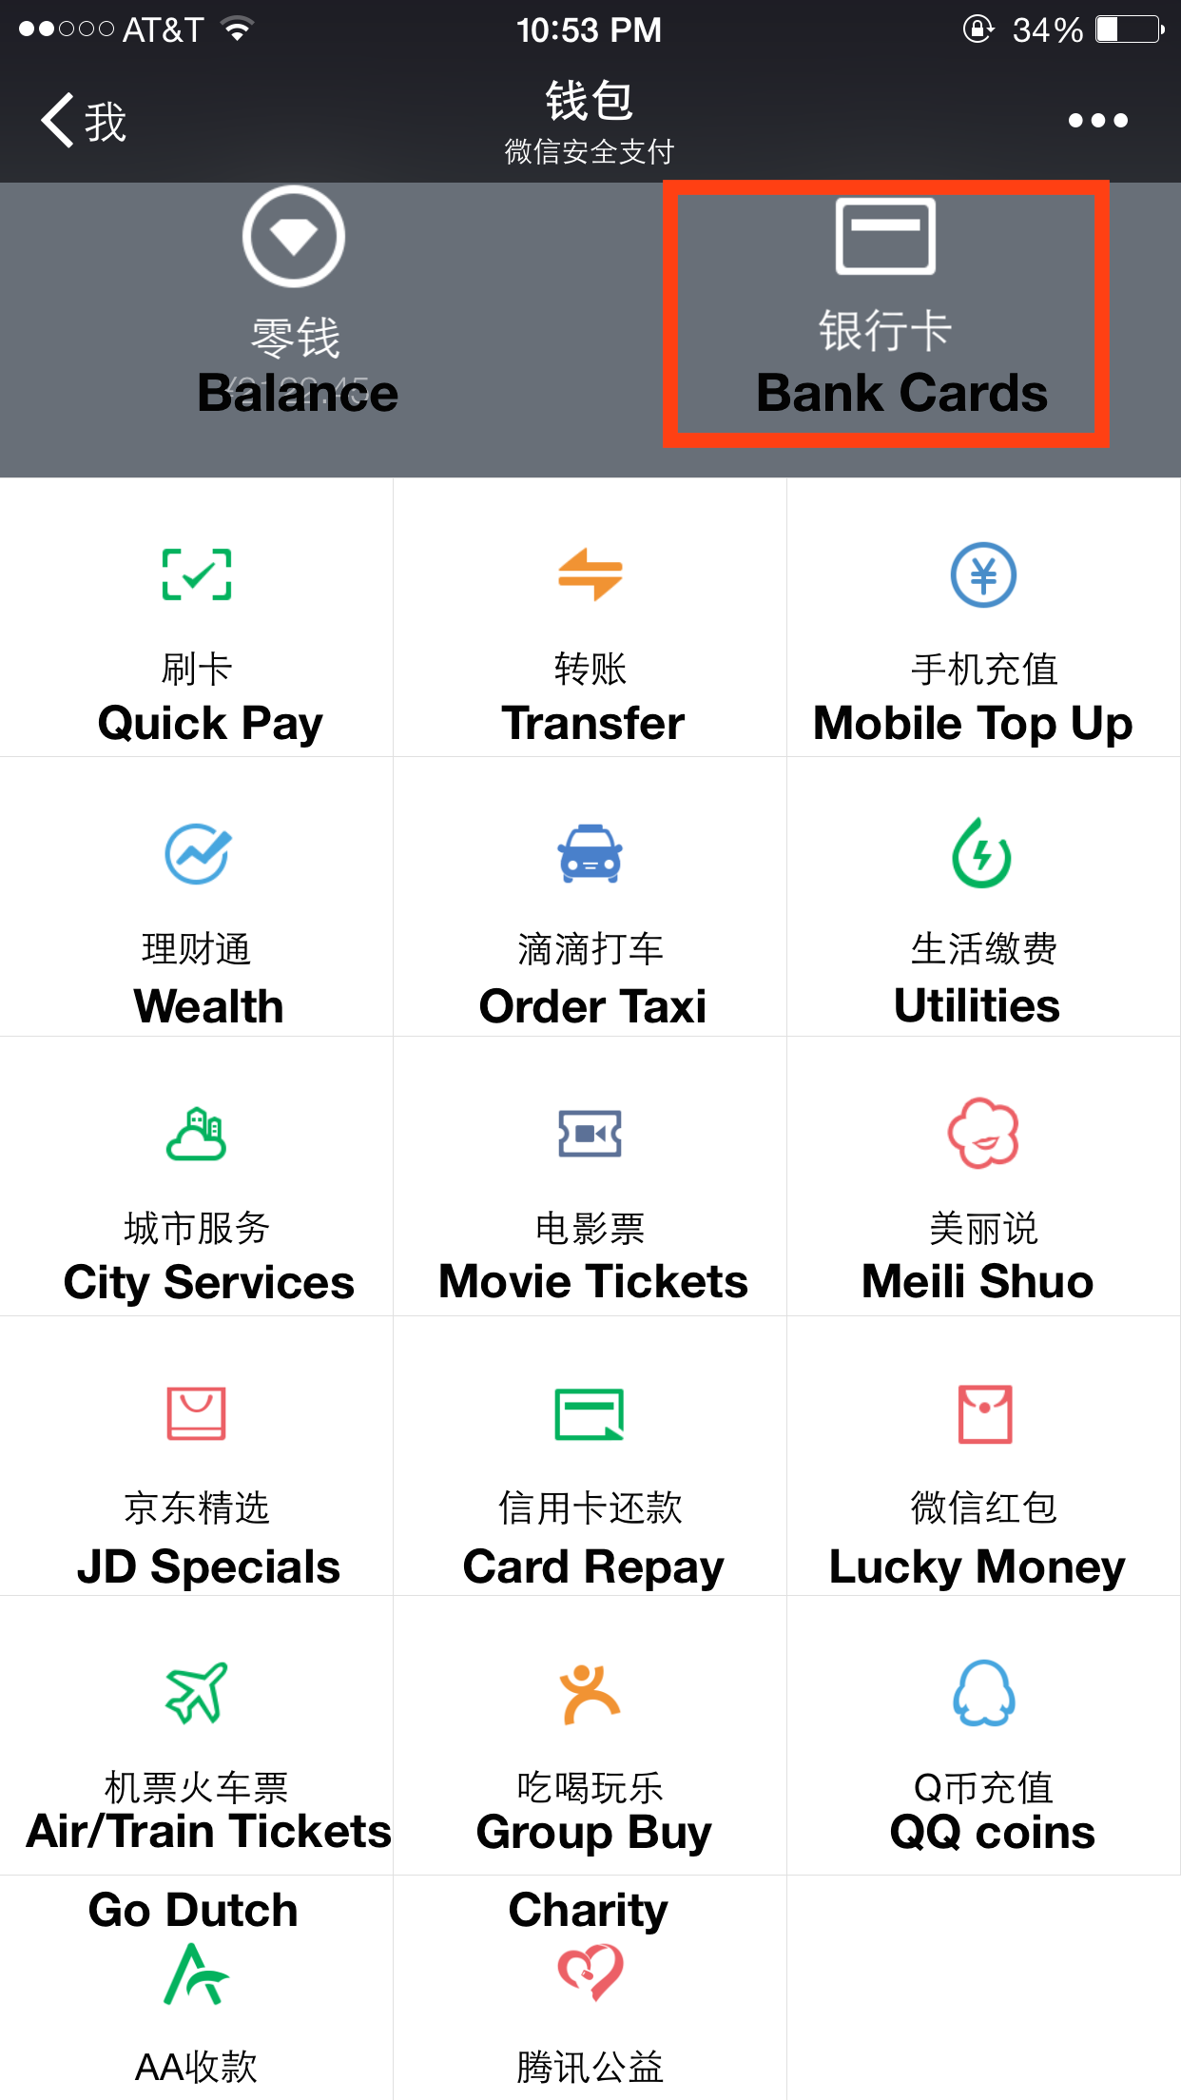


Slide 7

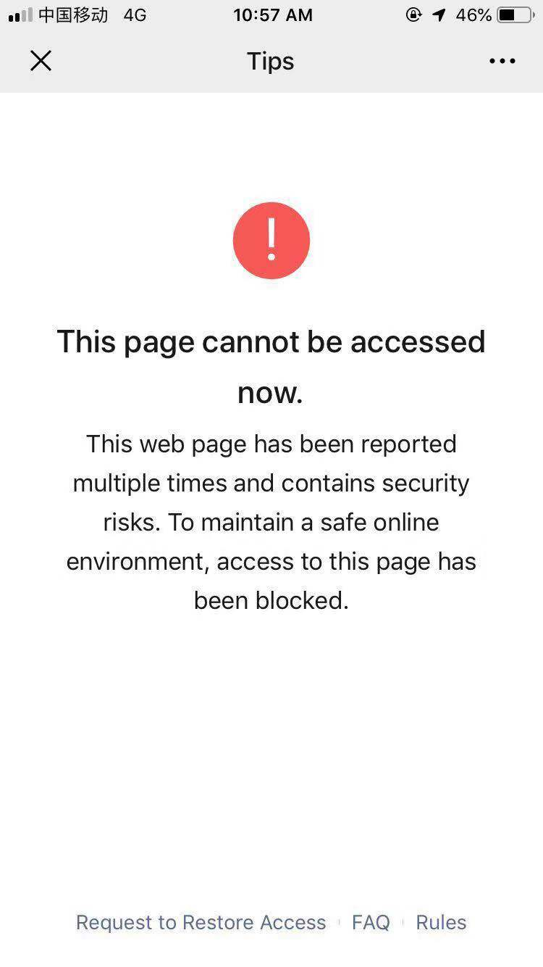
Censorship

Slide 8
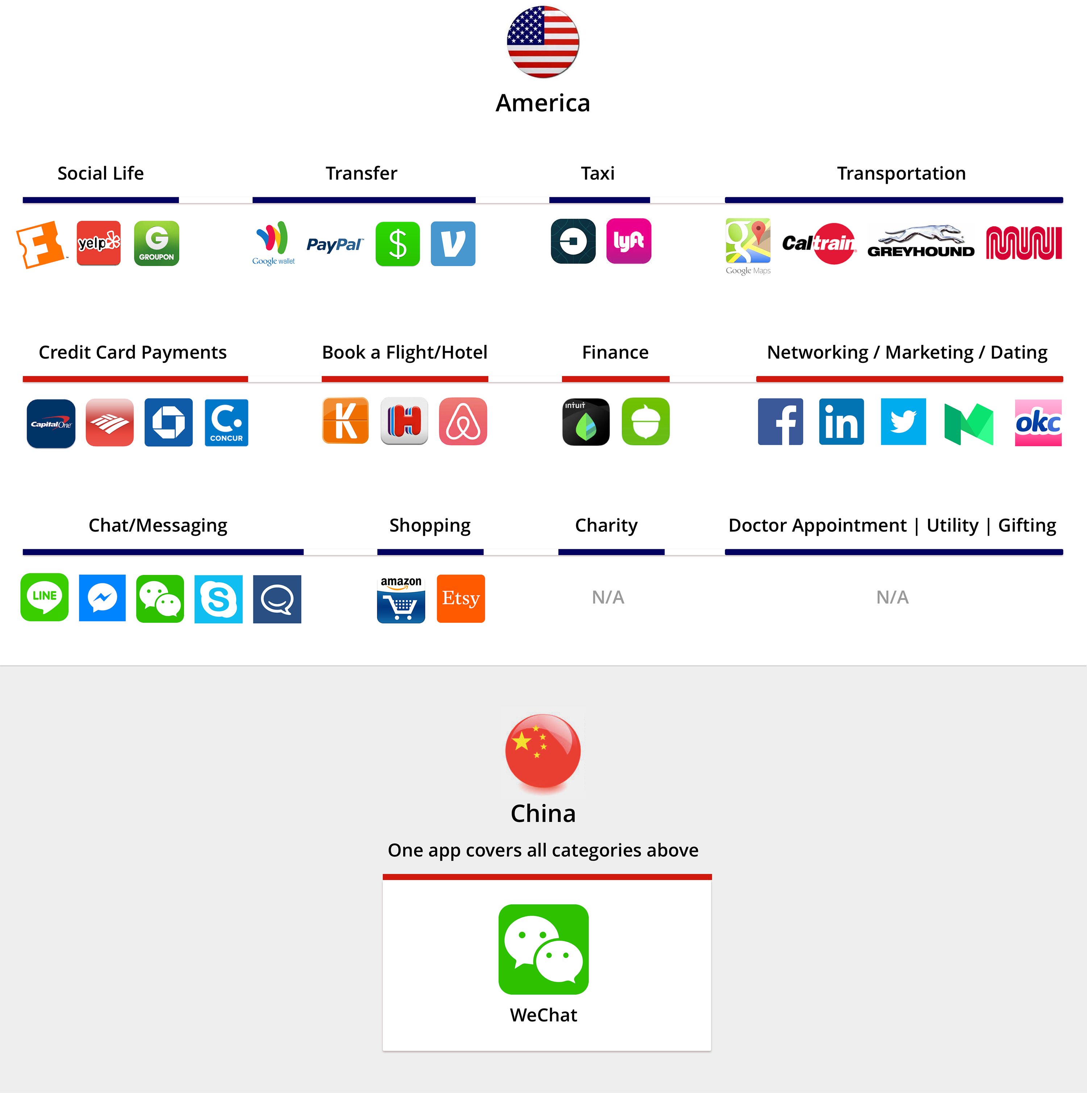
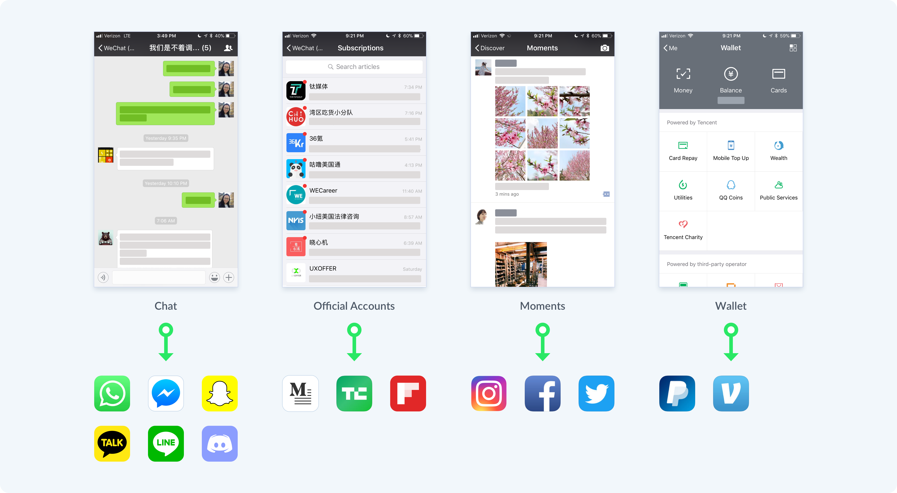

Slide 9
